Slide 1
BINGO PREFETCHER
Team Pipeliners

Slide 2

Insights: What and Why?
Exploits the similarity of access patterns among memory pages to prefetch
Associates them with both longer and shorter events
Notes:
Note- Memory pages are not the OS pages
Prefetcher based on similarity of access patterns in memory pages, i.e by storing event footprint pair in the history table
Uses both longer events and shorter events like the Tage predictor to combine the advantages of both of them
Long event - high accuracy, low opportunity
Short event- high opportunity, low accuracy
Bingo combines these to get best of both to cover cache misses and maintain accuracy

Slide 3
What and Why? (Slide 2)
Tag
One history table for both events? … redundancy
Less execution time and reducing storage overhead - BETTER RESULTS!
Index
“Short events being carried out in long events”
long
short
Redundant information
Notes:
For accessing patterns with both long and short events, we need more than one history table which increases storage overhead
Instead, we can exploit redundancy and scale down to one history table by observing that “Short events being carried out in long events”
Using one table where storing short event is used as index, and long event as a tag

Slide 4
Can Bingo fail sometimes?
Is the hash function used to encode “PC + offset” efficient?
Is the heuristic used for handling multiple footprints of same "PC + offset" fair?
Limitations are not limited...
Notes:
Should we treat
is Treating all the entries of a PC + offset equally correct?
Should some of them like - most recent ones be given more importance
Is the hashing efficiently splitting the data ( i.e taking sufficient information from the PC + offset )

Slide 5
JAL experiments...
Notes:
Jumping to experiments

Slide 6

Low five
Traces with least improvement for IPCP
620.omnetpp_s-141B.champsimtrace.xz
620.omnetpp_s-874B.champsimtrace.xz
657.xz_s-2302B.champsimtrace.xz
605.mcf_s-994B.champsimtrace.xz
600.perlbench_s-570B.champsimtrace.xz
Notes:
All our experiments in the project are performed on these five benchmarks. These are the ones that has lowest IPC when IPCP prefetcher is used

Slide 7
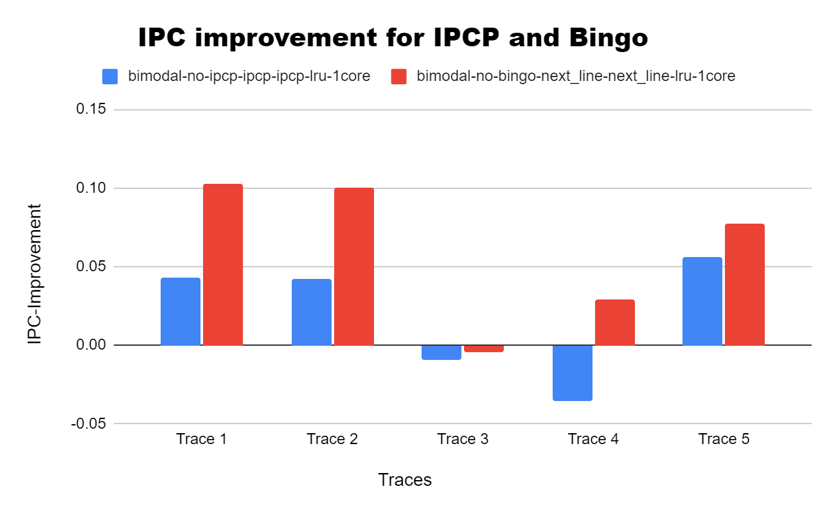
Bingo & IPCP
VS
Baseline
Warmup - 50M instructions
Simulation - 200M instructions
Notes:
in the plots we have used normalised IPC improvement i.e. experiment result divided by IPC with no prefetcher. And this is subtracted by 1, so that it is easy to visualise whether performance is improving or degrading

Slide 8
Bingo VS IPCP
Bingo > IPCP for all traces
Why 🤔🤔💬
IPCP uses fixed access patterns - constant & complex stride or streaming
IPCP uses fixed range of prefetch degree
Bingo uses both longer and shorter events
Bingo - 16 PC bits in index (>IPCP) with help of hashing
Notes:
For all the five traces we see that Bingo is performing better compared to IPCP
We tried to figure out the reasons by comparing their methods.
We found that IPCP uses fixed type of access patterns, but Bingo does not care about a particular type of pattern like constant stride or so. Instead it notes the footprint of accesses in few contiguos blocks of cache without looking for a pattern giving. This gives more flexibility to bingo
IPCP is also rigid in the sense that its prefetch degree range is fixed
Bingo uses multiple events unlike IPCP
And one other minor reason as per the implementations can be the number of bits in PC used for indexing. It is 10 bits in IPCP and 16 in Bingo

Slide 9

Bingo VS Baseline
IPC increases in general
...Is that always the case??
Notes:
In general with any prefetcher we expect IPC to increase

Slide 10
Bingo VS Baseline[2]
Trace 3 - Bingo performs worse than baseline
Why 🤔🤔💬
unfavourable evictions
unfavourable prefetches
benchmark might not be reusing the same data
Notes:
We see that for one of these benchmarks IPC is degrading as compared to without prefetcher
This is unusual and the reason could be that , bingo is actually doing some unnecessary

Slide 11

Let’s play with some numbers!!
Notes:
All the experiments are performed with 10M and 10M instructions

Slide 12
Experiments
10M Warm-up instructions, 10M Simulation instructions
For each modification, we plot IPC improvement ( = - 1 )
Modified Parameters
AT-size & FT-size
L1D_Thresh & L2C_Thresh
IPC with modified Bingo
IPC with default Bingo

Slide 13
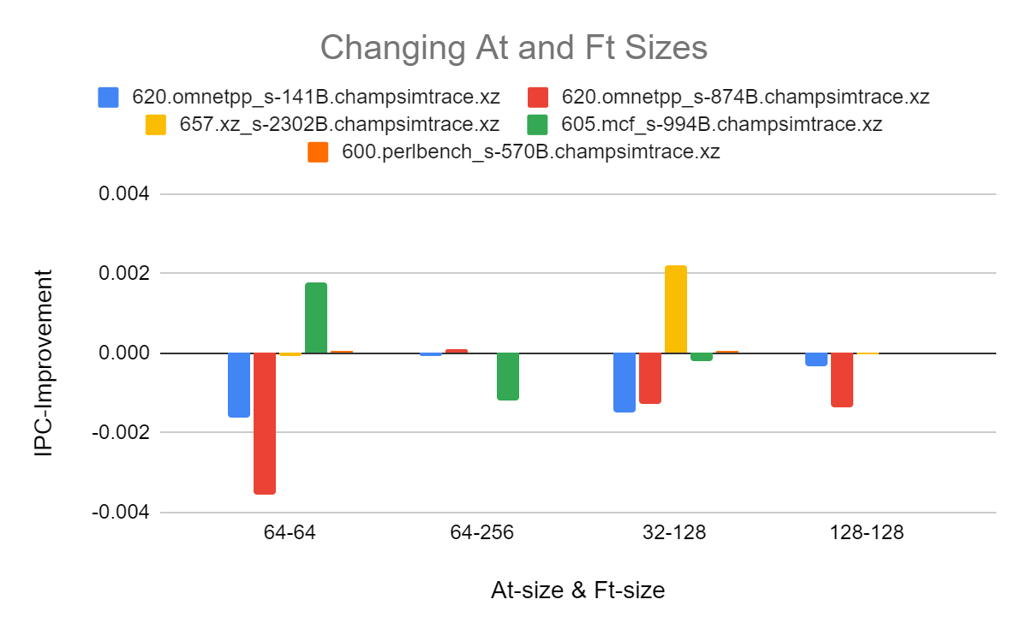
AT-size and FT-size
Default Accumulation table size - 64
Default Filter Table size - 128

Slide 14
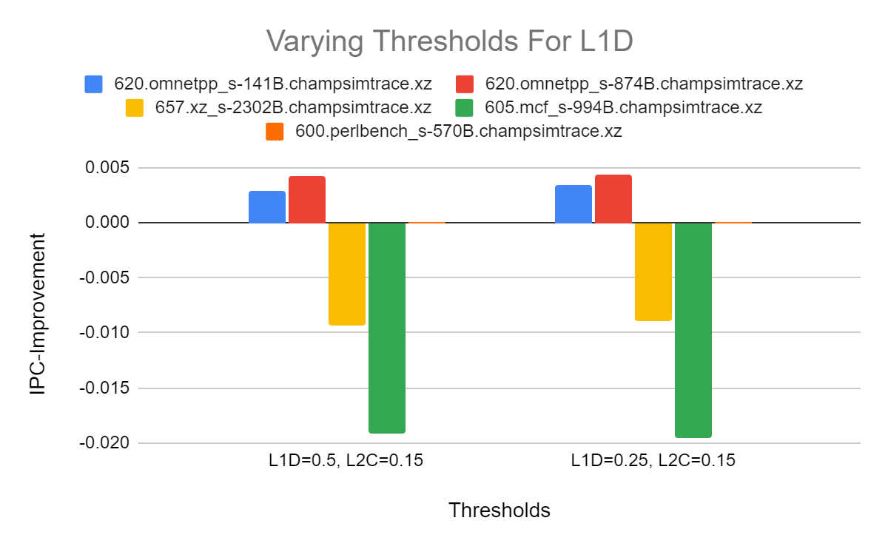
L1D & L2C Thresh
Default L1D threshold - 0.75
Default L2C threshold - 0.25
Decrease in threshold →
Prefetches increase but relevance decreases: opposing effects

Slide 15

We tried few more…
None of them actually worked :(
Let us try something new…..
Notes:
index_len, PHT size,

Slide 16
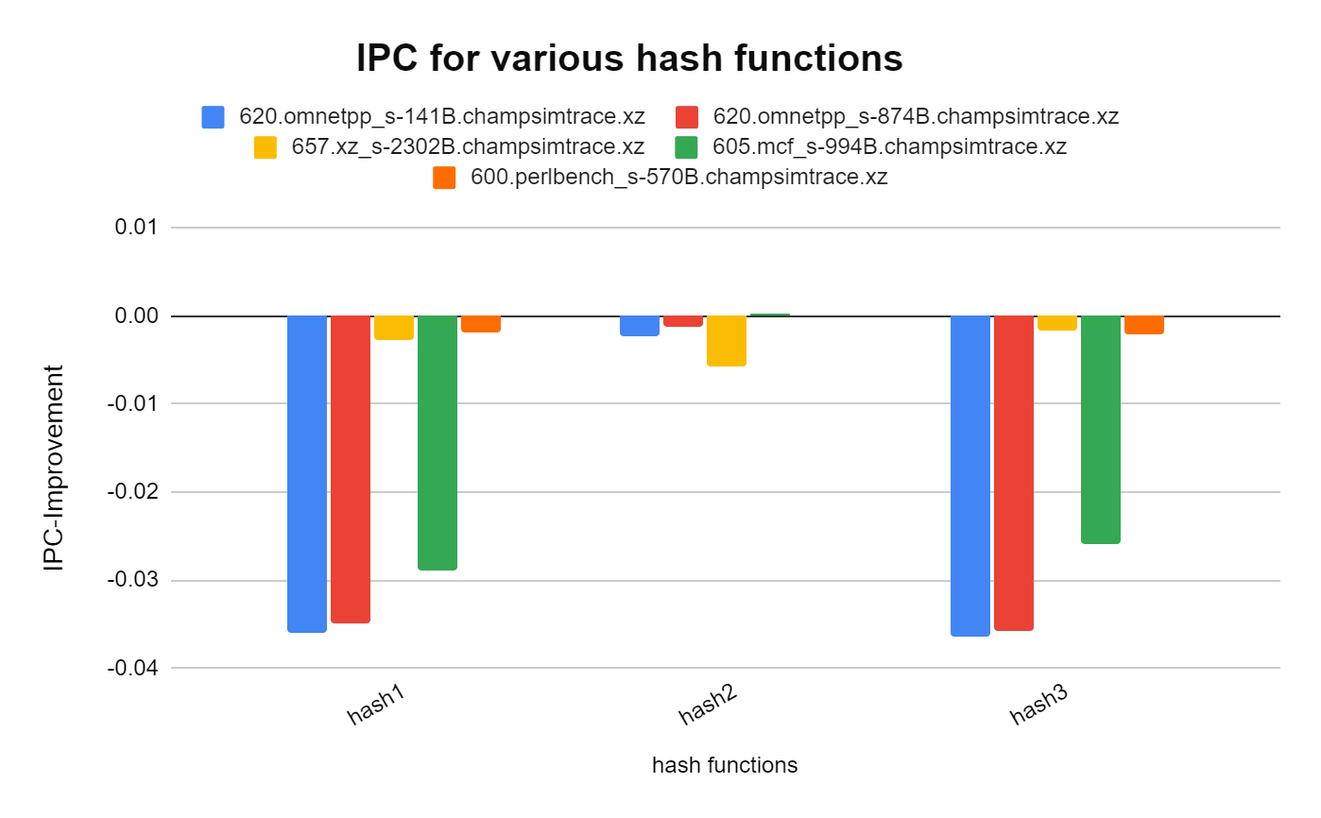
What if we change the Hash function?
hash 1 - https://stackoverflow.com/a/12996028
hash 2 - https://www.modernescpp.com/index.php/hash-functions
hash 3 - https://stackoverflow.com/a/57556517
Default hash function outperforms
- condenses info from entire key
1

Slide 17
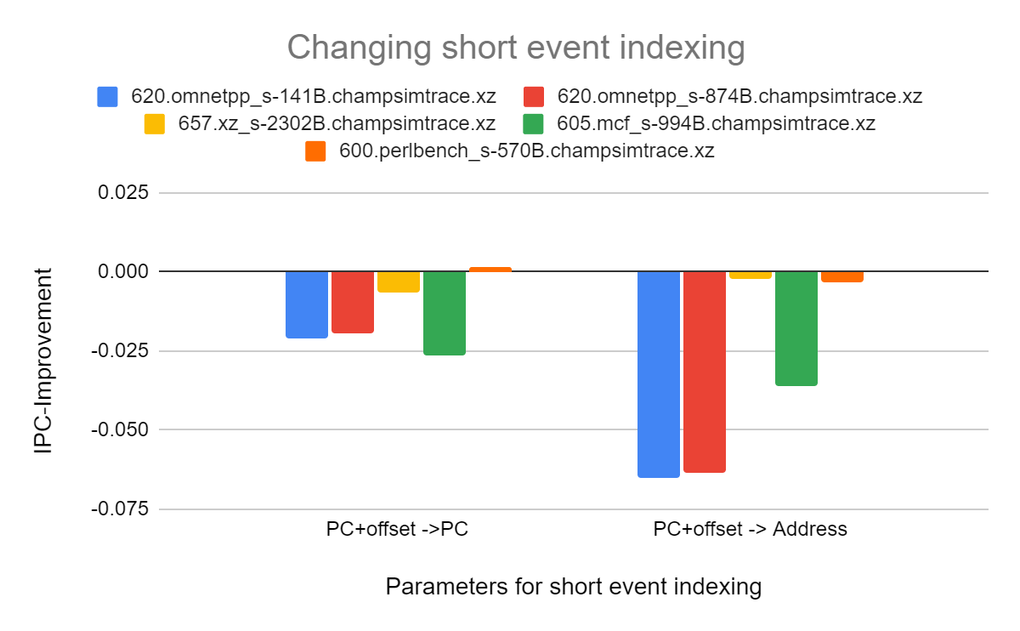
Possible Short events
Default indexing - PC+offset for short events
Replaced with
PC
Address
PC indexing decreases accuracy, increases match probability
Address indexing decreases accuracy and match probability

Slide 18

Failed Again…….. :(
But we won’t give up :)

Slide 19
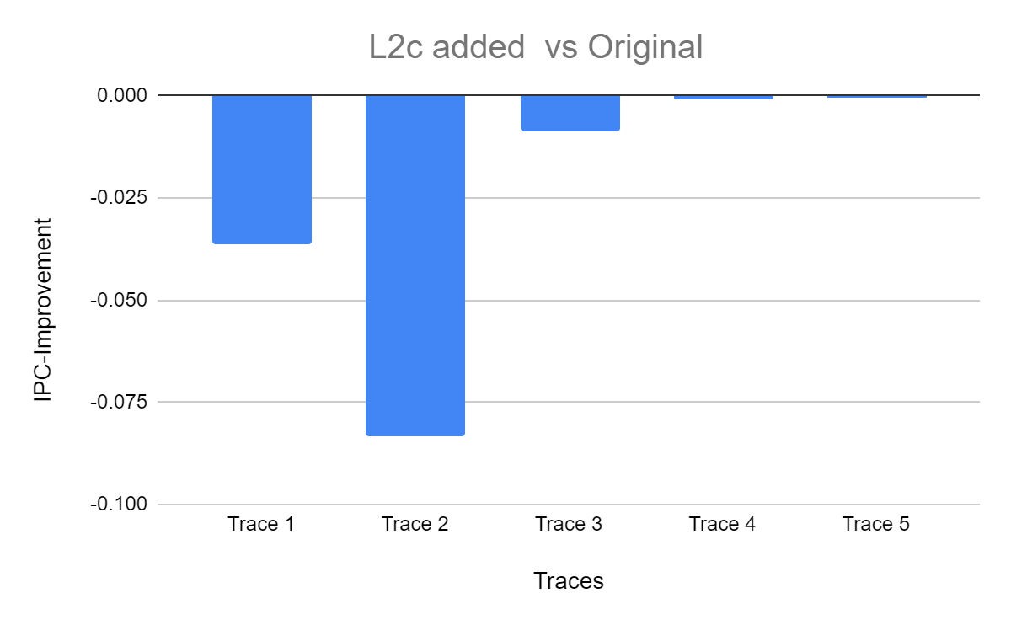
Bingo for L2C…….
L2C with Bingo parameters same as L1D
Notes:
Hoping for an improvement, we tried adding L2C Bingo prefetcher
Firstly, we performed experiment on traces with L2C prefetcher with same values of L1D prefetcher
IPC observed was almost similar, yet a slight decrease, might be because of additional prefetching time encountered by L2C

Slide 20

Restart the number-game….
Notes:
Is there any possibility of improvement by tuning parameters of L2C prefetcher… Lets find out

Slide 21
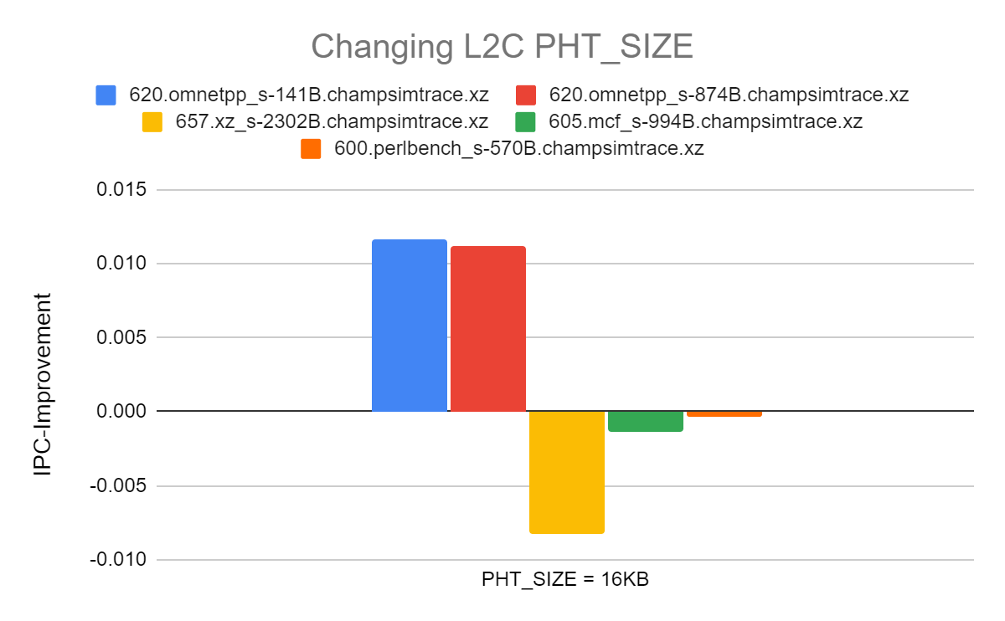
L2C PHT Size
1
Greater Pattern History Table(PHT) size for greater capacity
Able to store more history - might increase IPC
Notes:
We tried out increasing PHT size
With L2C having greater capacity, it is reasonable to take a greater size of history table as it will be able to store more history and more useful prefetches may happen
As we can see, IPC increases for few traces but also is decreasing for a few, the reason might be that unnecessary prefetches and evictions are happening
As L2C has greater capacity, greater PHT size might be useful for more useful prefetches

Slide 22
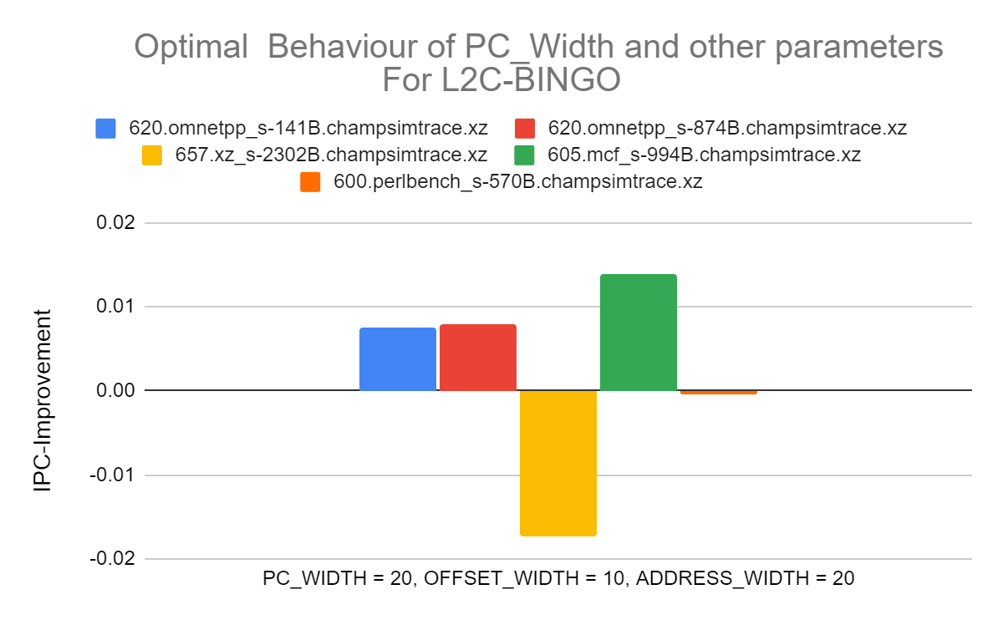
L2C Index and tag bits
Greater number of bits for extracting more information
More information → better prefetches
Notes:
Next, we modified the number of bits assigned for index and tag matching
With a greater number of bits, more information can be extracted about events which can result in greater number of prefetches
Here from the graph, we observe that IPC is increasing mostly, but the decrease for a few traces might be because the information extracted with more number of bits are not optimal

Slide 23
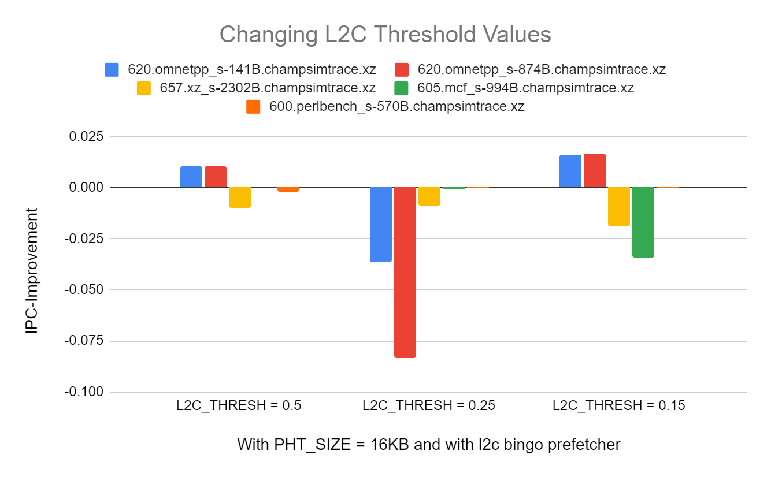
L2C Threshold in L2C prefetcher
Decrease in threshold →
Prefetches increase but relevance decreases: opposing effects
Notes:
Next, we tried modifying threshold value of L2C
With a decreasing threshold, number of prefetches increase, but how relevant the prefetches are with the present event decreases
With both the factors opposing each other, IPC can decrease or increase depending on trace behaviour

Slide 24
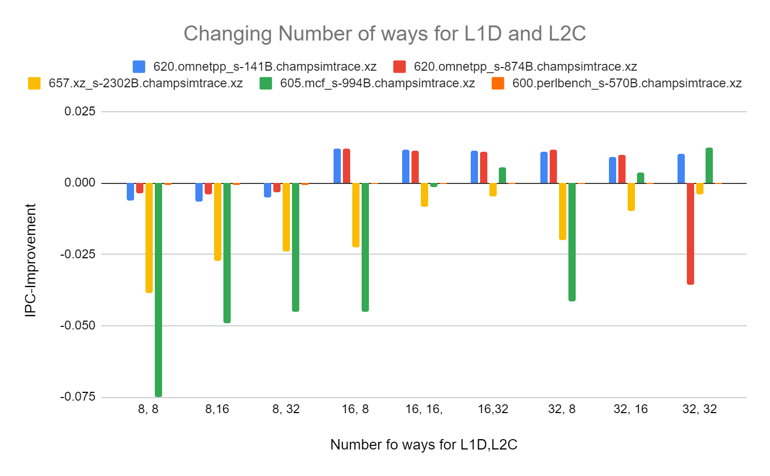
L1D and L2C ways
Default PHT ways in L1D - 16
Increase in ways →
Match probability for longer events increase
Notes:
Next, we modify number of ways for both L1D and L2C prefetcher
With a greater number of ways, there are more number of tags to be matched, which may increase the match probability for longer events

Slide 25
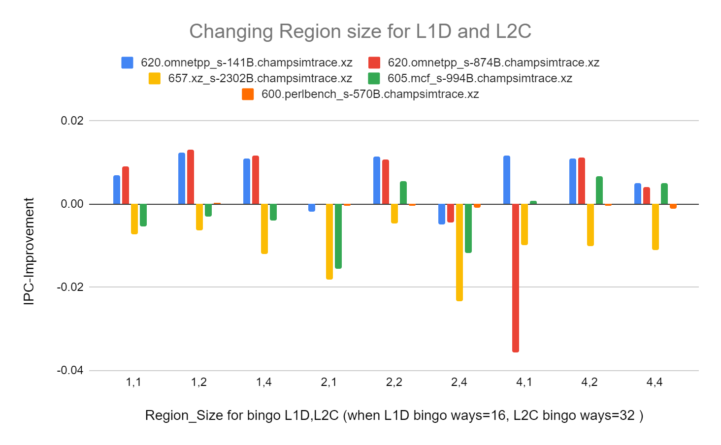
L1D and L2C Region Size
Default Region size for L1D - 2KB
Large region size contributes to large pattern length
Increasing pattern length →
prefetching time increases and number of useful prefetches increases - opposing factors
Notes:
Next, we tried changing the Region size which corresponds to unit of cache from which Bingo collects footprints for events
With an increased pattern length, more number of useful prefetches can happen, but simultaneously prefetching time increases
These 2 opposing factors might increase or decrease IPC depending on the behaviour of trace
In this way, we tried out various experiments to understand the behaviour of prefetcher
Lets conclude the results obtained, … over to Preetham

Slide 26


Conclusions
Tuning table sizes - AT, FT, PHT
No improvement on either increasing or decreasing table sizes
… default sizes are already optimal
Tuning L1D and L2C threshold
Improves for some traces and decreases for others
... increased prefetches, decreased relevance opposing each other
Exploring different short events
No improvement
… PC + offset might be optimal
Trying out different hash functions
No improvement
… default hashing might be optimal
Notes:
Default hashing takes more information, thats why it is optimal

Slide 27

Conclusions[2] → Extending Bingo to L2C
Played with PHT size, Index and Tag bits, number of ways and region size
On an average, best improvement obtained for
PHT size = 16K, Num ways = 32 & remaining same as L1D
Finally improvement! …by adding L2C prefetcher

Slide 28
Division of Labor
Name | Roll Number
Ilindra Lakshmi Sai Shreya | 190050050 | L2C, Reasons(20%)
Palti Ramyasri | 190050078 | L2C, Reasons(20%)
Pokala Mohith | 190050084 | L1D, Reasons(20%)
Poluparthi Preetham | 190050085 | L1D, Results and Plots(20%)
Punna Hitesh Kumar | 190050093 | L1D, Results and Plots(20%)

Slide 29

Arigatōgozaimas

